Slide 1
Bioinformatics Challenge
Andy Tran

Slide 2
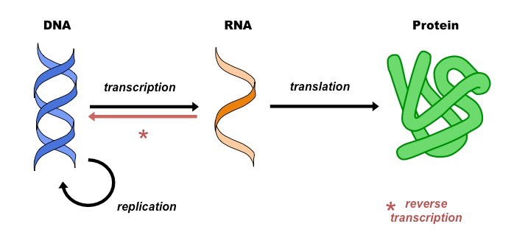
Background – The Central Dogma of Biology
Measuring RNA gives us an insight into the biological mechanisms in a tissue/cell.

Slide 3
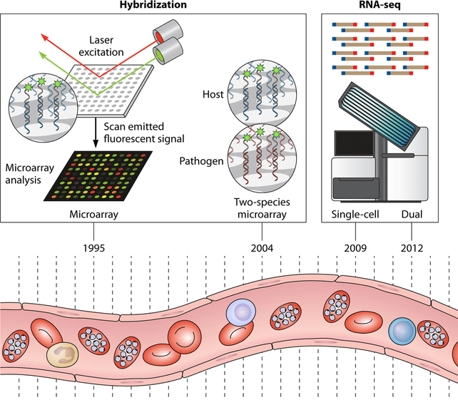
Background – RNA sequencing technology
Many technologies can be used to measure the amount of RNA in a tissue/cell
More modern technologies:
Single-cell
Single cell multiomics
Spatial transcriptomics
Any many more!

Slide 4
Research questions
Which genes are differentially expressed between two conditions?
For example:
Disease vs healthy
Treatment vs control
Early/late developmental stages
Early/late disease progression
Which biological functions/pathways are different between two conditions?

Slide 5
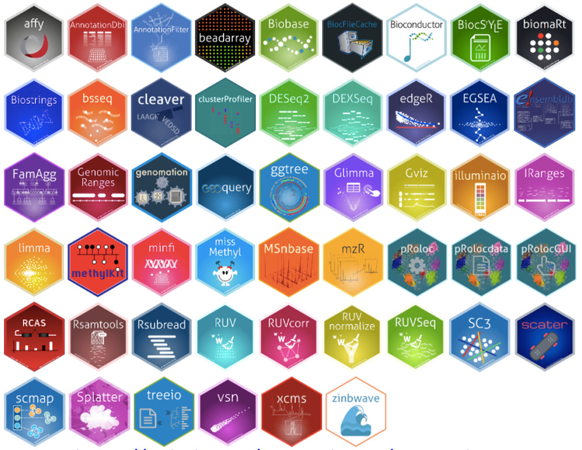

Analytical software
Fortunately, there is plenty of analytical software that has been developed
Unfortunately, there is plenty of analytical software that has been developed

Slide 6


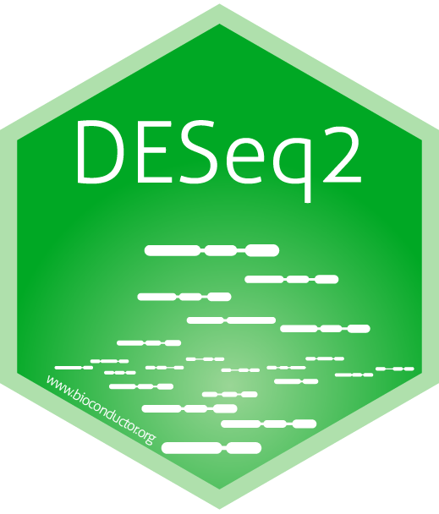
Differential Expression Analysis
Quantifies how differentially expressed each gene is between two conditions.
Generally uses a statistical test to standardise across genes and estimate significance.
Popular packages include: limma, edgeR and DESeq2.

Slide 7
DE Analysis: Suggested code
design <- model.matrix(~ classes)
limma.fit <- lmFit(exprs_mat, design)
limma.fit <- eBayes(limma.fit)
DEresults <- topTable(limma.fit, number = Inf, sort.by = "p")
datatable(DEresults)
Line 1: “classes” indicates the two conditions. model.matrix creates a matrix that tells limma which samples belong to which class.
Line 2: lmFit fits a linear model (equivalent to a t-test). exprs_mat is the expression matrix.
Line 3: eBayes calculates moderated t-statistics.
Line 4: topTable selects the top DE results and sorts them.
Line 5: datatable displays the results in a user-friendly table (requires package DT)

Slide 8
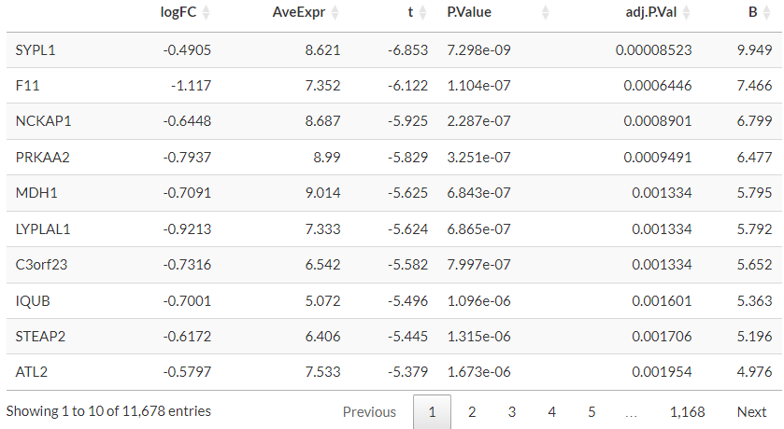
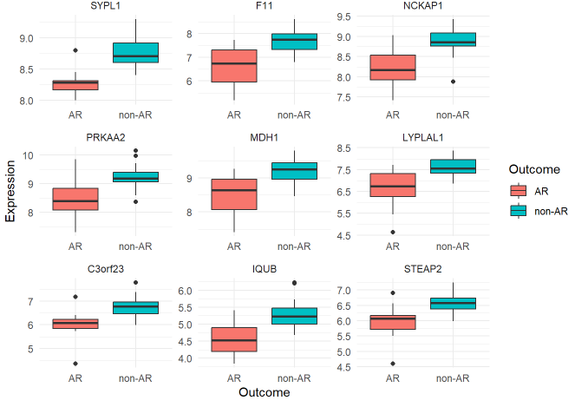
DE Analysis: Example
Gene
symbol
Log fold change
Average
Expression
Test
statistic
P value
Adjusted
P value
B statistic
Visualisation using ggplot (code not provided)

Slide 9
Gene Set Testing + Enrichment Analysis
From a DE analysis, which pathways (gene sets) are different between the two conditions?
Many databases of functional gene sets:
Gene Ontology (GO): cellular component, molecular function, biological process
Kyoto Encyclopedia of Genes and Genomes (KEGG)
Generally two main types of approaches:
Overrepresentation (similar to chi-squared test)
Enrichment (similar to Wilcoxon rank-sum test)
Popular packages include: clusterProfiler, gage, gsva, fgsea

Slide 10
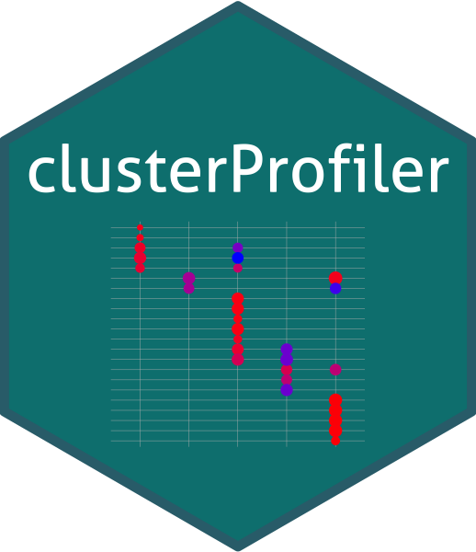
GSEA Analysis: Suggested code
gene_list <- -log10(DEresults$P.Value)
names(gene_list) <- rownames(DEresults)
gse <- gseGO(geneList=gene_list,
ont ="BP",
keyType = "SYMBOL",
OrgDb = org.Hs.eg.db)
datatable(gse@result)
Line 1: creates an ordered list of genes by differential expression and stores it in gene_list.
Line 2: names each element in gene_list by the gene symbol (a requirement for gseGO)
Line 3: gseGO performs the GSEA analysis. ont specifies the database to use (bp = biological process). keyType specifies the naming convention of the genes. OrgDb specifies the organism database (org.Hs.eg.db is for human)
Final line: outputs the result in a user friendly table. (requires package DT)

Slide 11
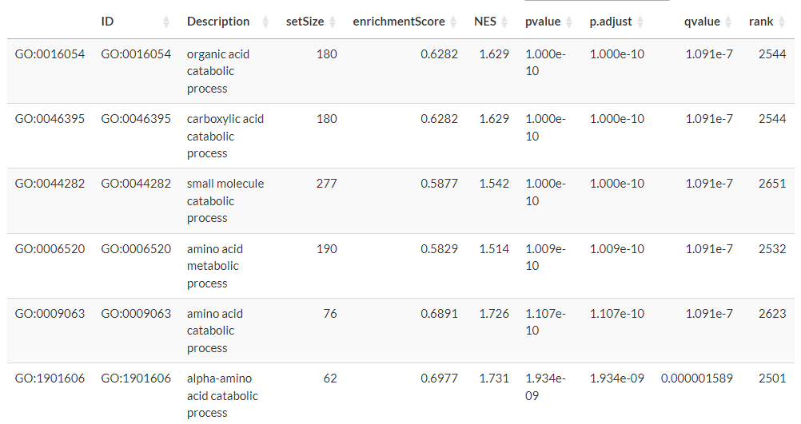
GSEA Analysis: Example
Pathway ID
Pathway Description
Pathway size
Enrichment Score
Normalised Enrichment score
P value
Adjusted
P value
Q-value
(FDR)
Rank of max enrichment

Slide 12
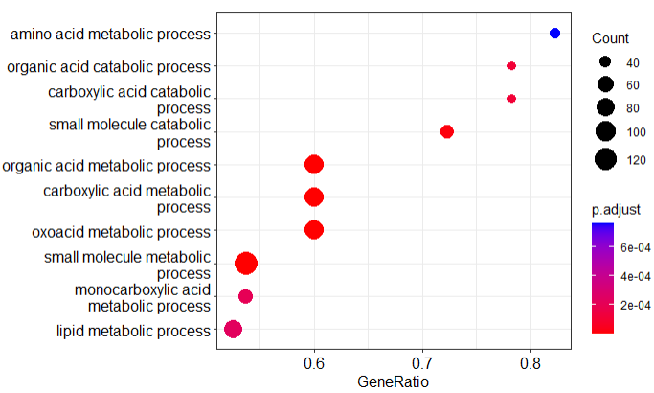
GSEA Analysis: Visualisation
Dotplot visualises the top terms with the size, adjusted p-value and gene ratio
dotplot(gse)

Slide 13
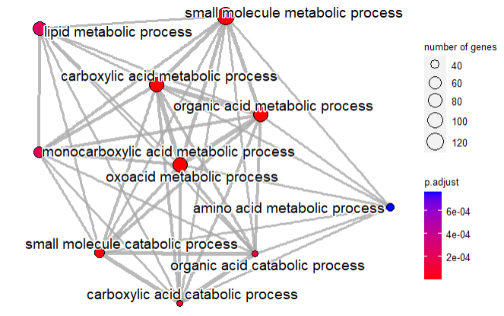
GSEA Analysis: Visualisation
Network plot visualises overlap and similarity between top terms
gse <- pairwise_termsim(gse)
emapplot(gse, showCategory = 10)

Slide 14
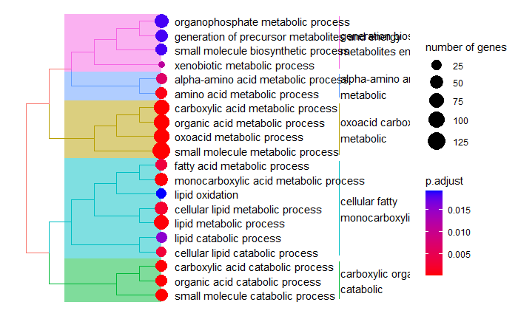
GSEA Analysis: Visualisation
Tree plot groups terms based on similarity
treeplot(gse)

Slide 15
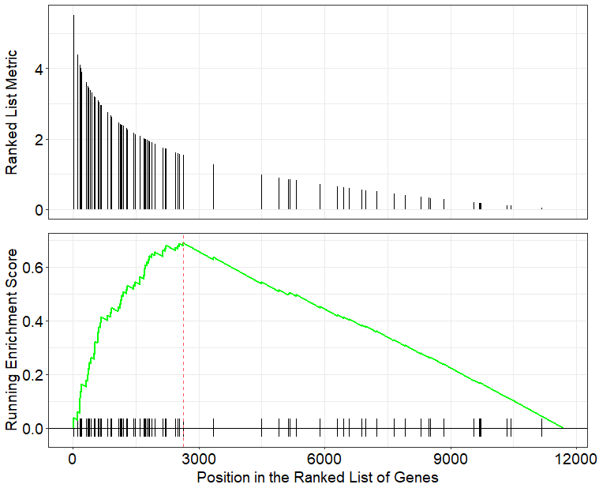
GSEA Analysis: Visualisation
Enrichment plot shows the GSEA result for an individual pathway
gseaplot(gse, path.id)

Slide 16
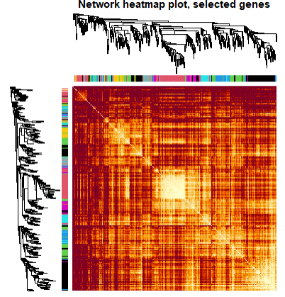
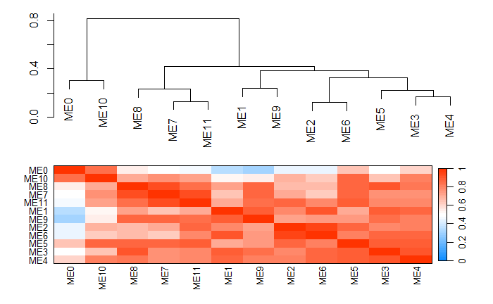
Advanced: WGCNA
Weighted Gene Coexpression Network Analysis
Analyses the relationship between genes in the data set: identifies modules of genes, and key genes.
All functions implemented in wgcna package.

Slide 17
Installing Packages
Install the required packages by running the following code in the terminal:
install.packages("BiocManager")
BiocManager::install(c("tidyverse", "plotly", "DT", "limma", "clusterProfiler", "org.Hs.eg.db", "enrichplot", "WGCNA"))
Load the packages in your R/rmd/qmd file with the following code:
library(tidyverse)
library(plotly)
library(DT)
library(limma)
library(clusterProfiler)
library(org.Hs.eg.db)
library(enrichplot)
library(WGCNA)

Slide 18
Additional Resources
Transcriptomics analysis workflow
Clusterprofiler tutorial
WGCNA tutorials

